Slide 1
Transaction Processing

Slide 2
Introduction to Transaction Processing
Single-User System:
  At most one user at a time can use the system.
Multiuser System:
  Many users can access the system concurrently.
Concurrency
  Interleaved processing:
    Concurrent execution of processes is interleaved in a single CPU
  Parallel processing:
    Processes are concurrently executed in multiple CPUs.

Slide 3
Introduction to Transaction Processing
A Transaction:
  Logical unit of database processing that includes one or more access operations (read -retrieval, write - insert or update, delete).
A transaction (set of operations) may be stand-alone specified in a high level language like SQL submitted interactively, or may be embedded within a program.
Transaction boundaries:
  Begin and End transaction.
An application program may contain several transactions separated by the Begin and End transaction boundaries.

Slide 4
Introduction to Transaction Processing
SIMPLE MODEL OF A DATABASE (for purposes of discussing transactions):
A database is a collection of named data items.
Granularity of data - a field, a record , or a whole disk block (Concepts are independent of granularity)
Basic operations are read and write
  read_item(X): Reads a database item named X into a program variable. To simplify our notation, we assume that the program variable is also named X.
  write_item(X): Writes the value of program variable X into the database item named X.

Slide 5
Introduction to Transaction Processing
READ AND WRITE OPERATIONS:
Basic unit of data transfer from the disk to the computer main memory is one block. In general, a data item (what is read or written) will be the field of some record in the database, although it may be a larger unit such as a record or even a whole block.

Slide 6
Introduction to Transaction Processing
READ AND WRITE OPERATIONS:
read_item(X) command includes the following steps:
  Find the address of the disk block that contains item X.
  Copy that disk block into a buffer in main memory (if that disk block is not already in some main memory buffer).
  Copy item X from the buffer to the program variable named X.

Slide 7
Introduction to Transaction Processing
READ AND WRITE OPERATIONS (contd.):
write_item(X) command includes the following steps:
  Find the address of the disk block that contains item X.
  Copy that disk block into a buffer in main memory (if that disk block is not already in some main memory buffer).
  Copy item X from the program variable named X into its correct location in the buffer.
  Store the updated block from the buffer back to disk (either immediately or at some later point in time).

Slide 8

Two sample transactions
FIGURE Two sample transactions:
  (a) Transaction T1
  (b) Transaction T2

Slide 9
Introduction to Transaction Processing
Why Concurrency Control is needed:
The Lost Update Problem
  This occurs when two transactions that access the same database items have their operations interleaved in a way that makes the value of some database item incorrect.

Slide 10
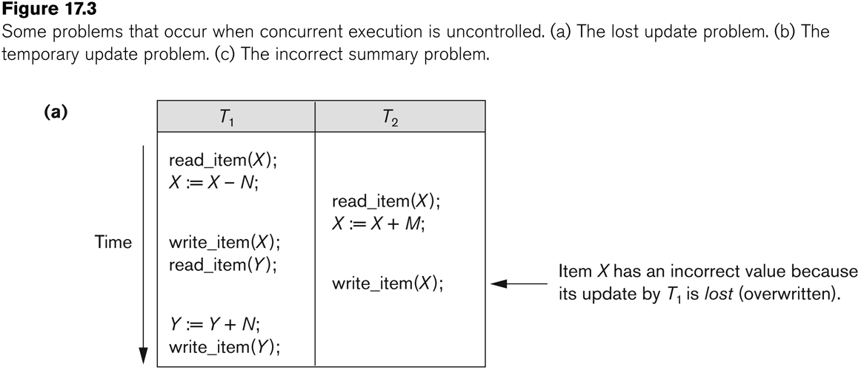
Concurrent execution is uncontrolled: (a) The lost update problem.

Slide 11
Introduction to Transaction Processing
Why Concurrency Control is needed:
Dirty Read Problem
  This occurs when one transaction updates a database item and then the transaction fails for some reason
  The updated item is accessed by another transaction before it is changed back to its original value.

Slide 12
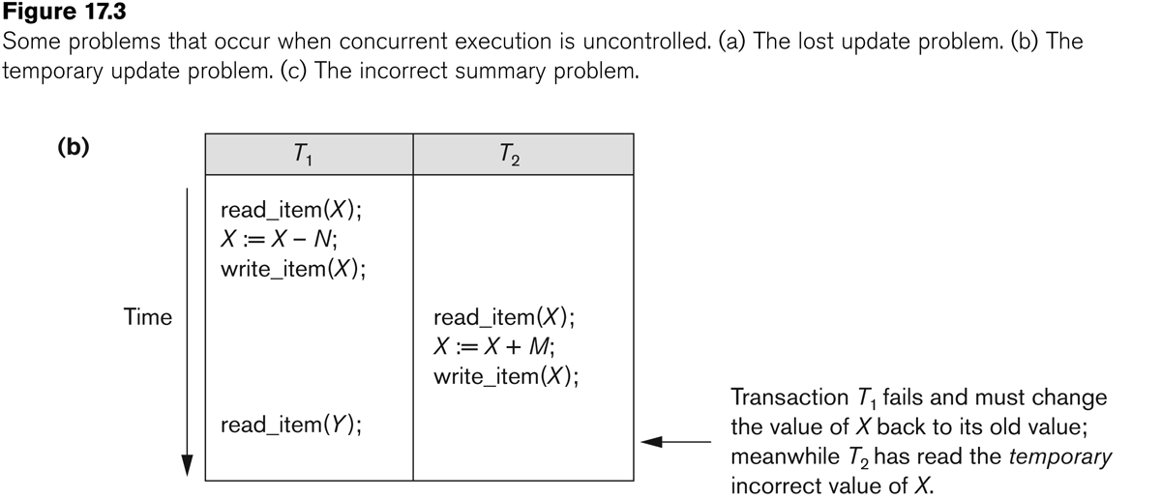
Concurrent execution is uncontrolled: (b) The temporary update problem.

Slide 13
Introduction to Transaction Processing
Why Concurrency Control is needed:
The Incorrect Summary Problem
  If one transaction is calculating an aggregate summary function on a number of records while other transactions are updating some of these records, the aggregate function may calculate some values before they are updated and others after they are updated.

Slide 14
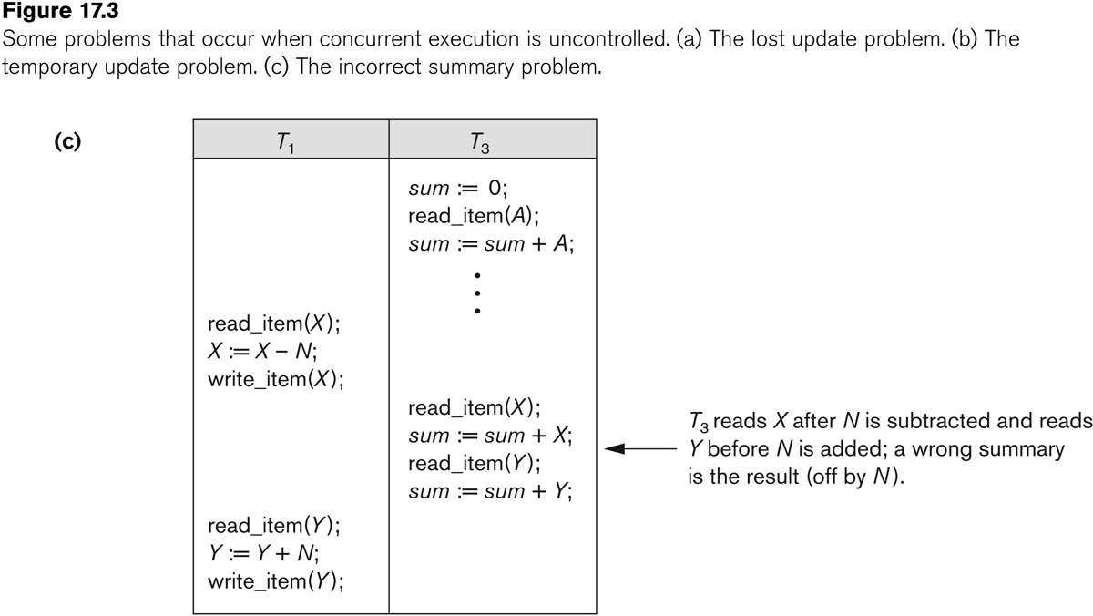
Concurrent execution is uncontrolled: (c) The incorrect summary problem.

Slide 15
Introduction to Transaction Processing
Why recovery is needed:
(What causes a Transaction to fail)
  1. A computer failure (system crash):
    A hardware or software error occurs in the computer system during transaction execution. If the hardware crashes, the contents of the computer’s internal memory may be lost.
  2. A transaction or system error:
    Some operation in the transaction may cause it to fail, such as integer overflow or division by zero. Transaction failure may also occur because of erroneous parameter values or because of a logical programming error. In addition, the user may interrupt the transaction during its execution.

Slide 16
Introduction to Transaction Processing
Why recovery is needed (Contd.):
(What causes a Transaction to fail)
  3. Local errors or exception conditions detected by the transaction:
    Certain conditions necessitate cancellation of the transaction. For example, data for the transaction may not be found. A condition, such as insufficient account balance in a banking database, may cause a transaction, such as a fund withdrawal from that account, to be canceled.
    A programmed abort in the transaction causes it to fail.
  4. Concurrency control enforcement:
    The concurrency control method may decide to abort the transaction, to be restarted later, because it violates serializability or because several transactions are in a state of deadlock.

Slide 17
Introduction to Transaction Processing
Why recovery is needed (contd.):
(What causes a Transaction to fail)
  5. Disk failure:
    Some disk blocks may lose their data because of a read or write malfunction or because of a disk read/write head crash. This may happen during a read or a write operation of the transaction.
  6. Physical problems and catastrophes:
    This refers to an endless list of problems that includes power or air-conditioning failure, fire, theft, sabotage, overwriting disks or tapes by mistake, and mounting of a wrong tape by the operator.

Slide 18
Desirable Properties of Transactions
ACID properties:
Atomicity: A transaction is an atomic unit of processing; it is either performed in its entirety or not performed at all.
Consistency preservation: A correct execution of the transaction must take the database from one consistent state to another.
Isolation: A transaction should not make its updates visible to other transactions until it is committed; this property, when enforced strictly, solves the temporary update problem and makes cascading rollbacks of transactions unnecessary
Durability or permanency: Once a transaction changes the database and the changes are committed, these changes must never be lost because of subsequent failure.

Slide 19
Transaction and System Concepts
A transaction is an atomic unit of work that is either completed in its entirety or not done at all.
  For recovery purposes, the system needs to keep track of when the transaction starts, terminates, and commits or aborts.
Transaction states:
    Active state
    Partially committed state
    Committed state
    Failed state
    Terminated State

Slide 20
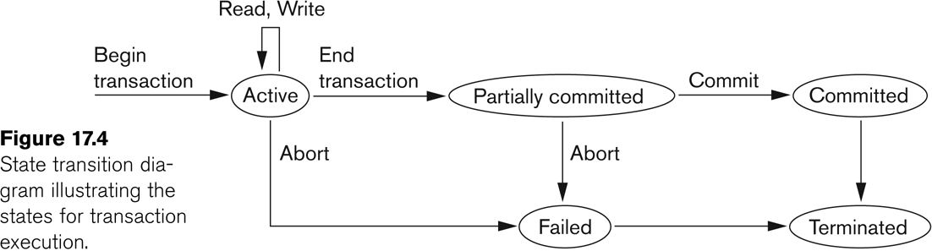
State transition diagram illustrating the states for transaction execution

Slide 21
Transaction and System Concepts
Recovery manager keeps track of the following operations:
  begin_transaction: This marks the beginning of transaction execution.
  read or write: These specify read or write operations on the database items that are executed as part of a transaction.
  end_transaction: This specifies that read and write transaction operations have ended and marks the end limit of transaction execution.
    At this point it may be necessary to check whether the changes introduced by the transaction can be permanently applied to the database or whether the transaction has to be aborted because it violates concurrency control or for some other reason.

Slide 22
Transaction and System Concepts
Recovery manager keeps track of the following operations (cont):
  commit_transaction: This signals a successful end of the transaction so that any changes (updates) executed by the transaction can be safely committed to the database and will not be undone.
  rollback (or abort): This signals that the transaction has ended unsuccessfully, so that any changes or effects that the transaction may have applied to the database must be undone.

Slide 23
Transaction and System Concepts
Recovery techniques use the following operators:
  undo: Similar to rollback except that it applies to a single operation rather than to a whole transaction.
  redo: This specifies that certain transaction operations must be redone to ensure that all the operations of a committed transaction have been applied successfully to the database.

Slide 24
Transaction and System Concepts
The System Log
  Log or Journal: The log keeps track of all transaction operations that affect the values of database items.
    This information may be needed to permit recovery from transaction failures.
    The log is kept on disk, so it is not affected by any type of failure except for disk or catastrophic failure.
    In addition, the log is periodically backed up to archival storage (tape) to guard against such catastrophic failures.

Slide 25
Transaction and System Concepts
The System Log (cont):
  T in the following discussion refers to a unique transaction-id that is generated automatically by the system and is used to identify each transaction:
  Types of log record:
    [start_transaction,T]: Records that transaction T has started execution.
    [write_item,T,X,old_value,new_value]: Records that transaction T has changed the value of database item X from old_value to new_value.
    [read_item,T,X]: Records that transaction T has read the value of database item X.
    [commit,T]: Records that transaction T has completed successfully, and affirms that its effect can be committed (recorded permanently) to the database.
    [abort,T]: Records that transaction T has been aborted.

Slide 26
Transaction and System Concepts
The System Log (cont):
  Protocols for recovery that avoid cascading rollbacks do not require that read operations be written to the system log, whereas other protocols require these entries for recovery.
  Strict protocols require simpler write entries that do not include new_value.

Slide 27
Transaction and System Concepts
Recovery using log records:
If the system crashes, we can recover to a consistent database state by examining the log and using one of the techniques.
Because the log contains a record of every write operation that changes the value of some database item, it is possible to undo the effect of these write operations of a transaction T by tracing backward through the log and resetting all items changed by a write operation of T to their old_values.
We can also redo the effect of the write operations of a transaction T by tracing forward through the log and setting all items changed by a write operation of T (that did not get done permanently) to their new_values.

Slide 28
Transaction and System Concepts
Commit Point of a Transaction:
Definition a Commit Point:
  A transaction T reaches its commit point when all its operations that access the database have been executed successfully and the effect of all the transaction operations on the database has been recorded in the log.
  Beyond the commit point, the transaction is said to be committed, and its effect is assumed to be permanently recorded in the database.
  The transaction then writes an entry [commit,T] into the log.
Roll Back of transactions:
  Needed for transactions that have a [start_transaction,T] entry into the log but no commit entry [commit,T] into the log.

Slide 29
Transaction and System Concepts
Commit Point of a Transaction (cont):
Redoing transactions:
  Transactions that have written their commit entry in the log must also have recorded all their write operations in the log; otherwise they would not be committed, so their effect on the database can be redone from the log entries. (Notice that the log file must be kept on disk.
  At the time of a system crash, only the log entries that have been written back to disk are considered in the recovery process because the contents of main memory may be lost.)
Force writing a log:
  Before a transaction reaches its commit point, any portion of the log that has not been written to the disk yet must now be written to the disk.
  This process is called force-writing the log file before committing a transaction.

Slide 30
Schedule
Transaction schedule or history:
  When transactions are executing concurrently in an interleaved fashion, the order of execution of operations from the various transactions forms what is known as a transaction schedule (or history).
A schedule (or history) S of n transactions T1, T2, …, Tn:
  It is an ordering of the operations of the transactions subject to the constraint that, for each transaction Ti that participates in S, the operations of Ti in S must appear in the same order in which they occur in Ti.
  Note, however, that operations from other transactions Tj can be interleaved with the operations of Ti in S.

Slide 31
Characterizing Schedules based on Recoverability
Recoverable schedule:
  One where no transaction needs to be rolled back.
  A schedule S is recoverable if no transaction T in S commits until all transactions T’ that have written an item that T reads have committed.
    Otherwise, the schedule is called nonrecoverable schedule.
Cascadeless schedule (avoid cascading rollback):
  One where every transaction reads only the items that are written by committed transactions.

Slide 32
Recoverable schedule:
  S_{a} : r1(x);r2(x);w1(x);r1(y);w2(x);c2;w1(y);c1;
  S_{b} : r1(x);w1(x);r2(x);r1(y);w2(x);w1(y);c1;c2;
Nonrecoverable schedule:
  S_{c} : r1(x);w1(x);r2(x);r1(y);w2(x);c2;a1;
Schedules requiring cascaded rollback:
  S_{d} : r1(x);w1(x);r2(x);r1(y);w2(x);w1(y),a1;a2;
Cascadeless schedule (avoid cascading rollback):
- r2(x) of S_{b} & S_{d} delayed, until after t1 has committed or aborted.

Slide 33
Characterizing Schedules based on Recoverability
Schedules requiring cascaded rollback:
  A schedule in which uncommitted transactions that read an item from a failed transaction must be rolled back.
Strict Schedules:
  A schedule in which a transaction can neither read nor write an item X until the last transaction that wrote X has committed (or aborted).
  Ensures cascadeless rollback.

Slide 34
Characterizing Schedules based on Serializability
Serial schedule:
  A schedule S is serial if, for every transaction T participating in the schedule, all the operations of T are executed consecutively in the schedule.
    Otherwise, the schedule is called nonserial schedule.
Serializable schedule:
  A schedule S is serializable if it is equivalent to some serial schedule of the same n transactions.

Slide 35
Characterizing Schedules based on Serializability
Conflicting operations:
Two operations are said to conflict if they satisfy all three of the following conditions:
  they belong to different transactions
  they access the same item X
  atleast one of the operations is a write_item(x)

Slide 36
Characterizing Schedules based on Serializability
Result equivalent:
  Two schedules are called result equivalent if they produce the same final state of the database.
Conflict equivalent:
  Two schedules are said to be conflict equivalent if the order of any two conflicting operations is the same in both schedules.
Conflict serializable:
  A non serial schedule S is said to be conflict serializable if it is conflict equivalent to some serial schedule S’.

Slide 37
Characterizing Schedules based on Serializability
Being serializable is not the same as being serial.
Being serializable implies that the schedule is a correct schedule.
  It will leave the database in a consistent state.
  The interleaving is appropriate and will result in a state as if the transactions were serially executed, yet will achieve efficiency due to concurrent execution.

Slide 38
Characterizing Schedules based on Serializability
View equivalence:
  A less restrictive definition of equivalence of schedules
View serializability:
  Definition of serializability based on view equivalence.
  A schedule is view serializable if it is view equivalent to a serial schedule.

Slide 39
Characterizing Schedules based on Serializability
Two schedules are said to be view equivalent if the following three conditions hold:
  The same set of transactions participates in S and S’, and S and S’ include the same operations of those transactions.
  For any operation R_{i}(X) of T_{i} in S, if the value of X read by the operation has been written by an operation W_{j}(X) of T_{j} (or if it is the original value of X before the schedule started), the same condition must hold for the value of X read by operation R_{i}(X) of T_{i} in S’.
  If the operation W_{k}(Y) of T_{k} is the last operation to write item Y in S, then W_{k}(Y) of T_{k} must also be the last operation to write item Y in S’.

Slide 40
Characterizing Schedules based on Serializability
The premise behind view equivalence:
  As long as each read operation of a transaction reads the result of the same write operation in both schedules, the write operations of each transaction must produce the same results.
  “The view”: the read operations are said to see the same view in both schedules.

Slide 41
Characterizing Schedules based on Serializability
Relationship between view and conflict equivalence:
  The two are same under constrained write assumption which assumes that if T writes X, it is constrained by the value of X it read; i.e., new X = f(old X).
  Conflict serializability is stricter than view serializability. With unconstrained write (or blind write), a schedule that is view serializable is not necessarily conflict serializable.
  Any conflict serializable schedule is also view serializable, but not vice versa.

Slide 42
Characterizing Schedules based on Serializability
Relationship between view and conflict equivalence (cont):
  Consider the following schedule of three transactions
    T1: r1(X), w1(X); T2: w2(X); and T3: w3(X):
  Schedule S_{a}: r1(X); w2(X); w1(X); w3(X); c1; c2; c3;
In S_{a}, the operations w2(X) and w3(X) are blind writes, since T2 and T3 do not read the value of X.
  S_{a} is view serializable, since it is view equivalent to the serial schedule T1, T2, T3.
  However, S_{a} is not conflict serializable, since it is not conflict equivalent to any serial schedule.

Slide 43
Characterizing Schedules based on Serializability
Testing for conflict serializability: Algorithm :
  Looks at only read_Item (X) and write_Item (X) operations
  Constructs a precedence graph (serialization graph) - a graph with directed edges
  An edge is created from T_{i} to T_{j} if one of the operations in T_{i} appears before a conflicting operation in T_{j}
  The schedule is serializable if and only if the precedence graph has no cycles.

Slide 44
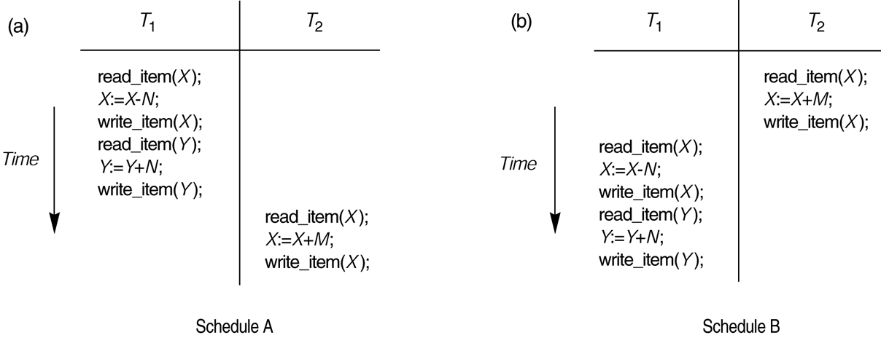
Examples of serial and nonserial schedules involving transactions T₁ and T₂.
(a) Serial schedule A: T₁ followed by T₂.
(b) Serial schedules B: T₂ followed by T₁.

Slide 45
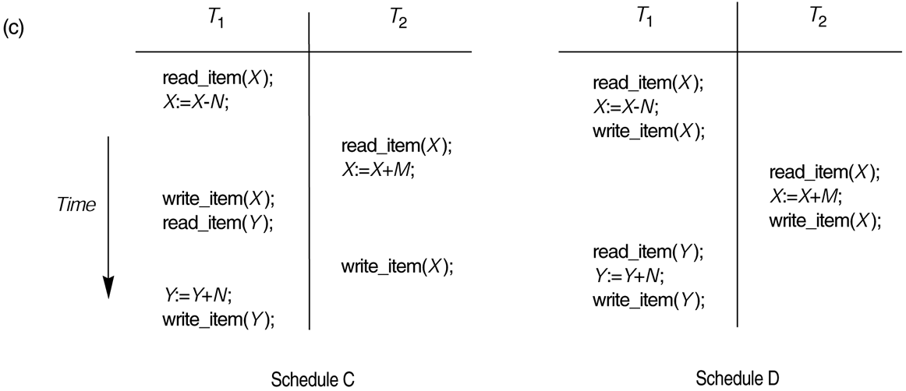
Examples of serial and nonserial schedules involving transactions T₁ and T₂.
(c) Two nonserial schedules C and D with interleaving of operations.

Slide 46
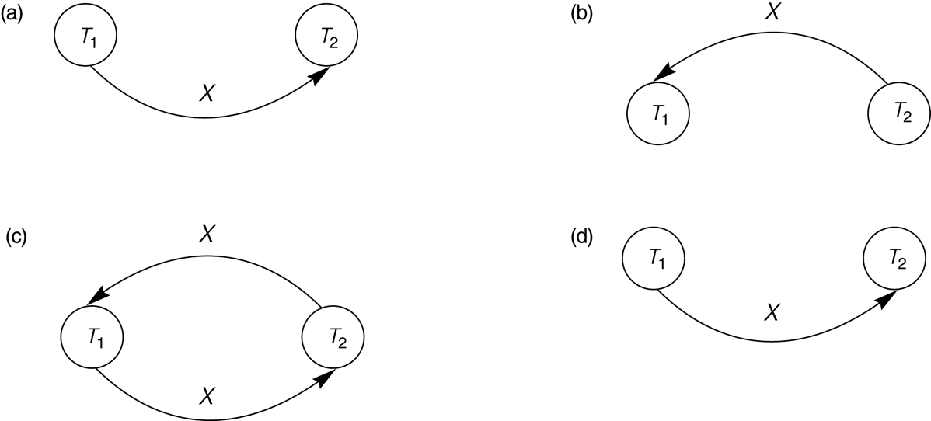
Constructing the Precedence Graphs
FIGURE Constructing the precedence graphs for schedules A and D from previous Figure to test for conflict serializability.
  (a) Precedence graph for serial schedule A.
  (b) Precedence graph for serial schedule B.
  (c) Precedence graph for schedule C (not serializable).
  (d) Precedence graph for schedule D (serializable, equivalent to schedule A).

Slide 47
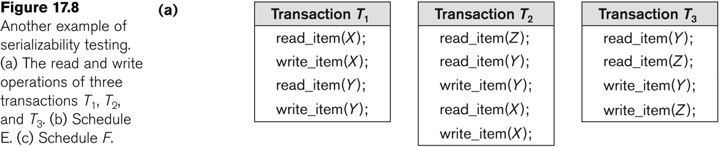
Another example of serializability Testing

Slide 48
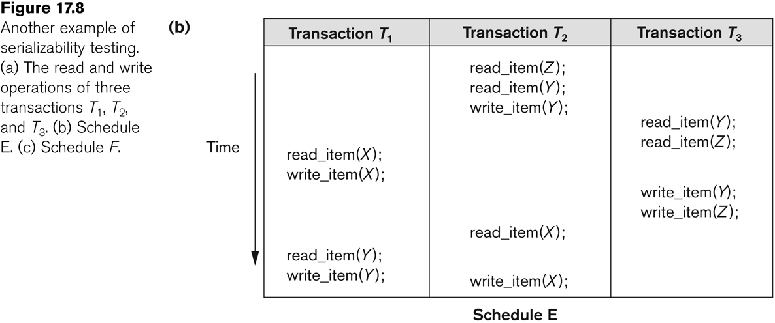
Another Example of Serializability Testing

Slide 49
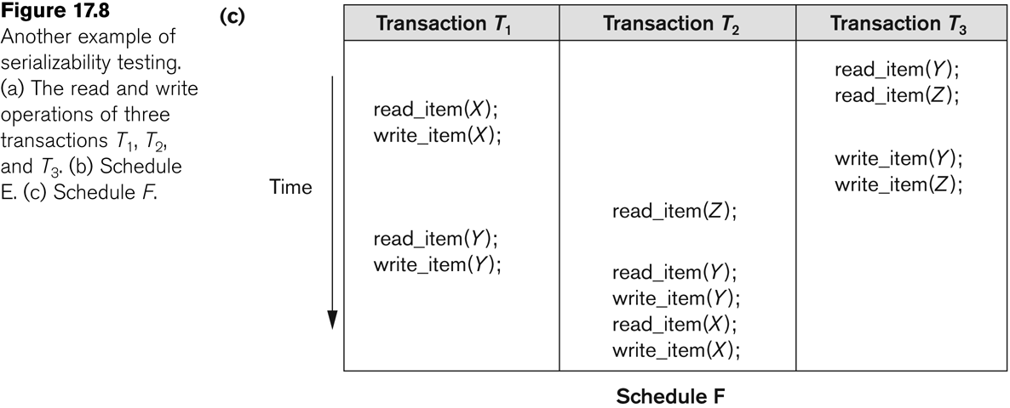
Another Example of Serializability Testing

Slide 50
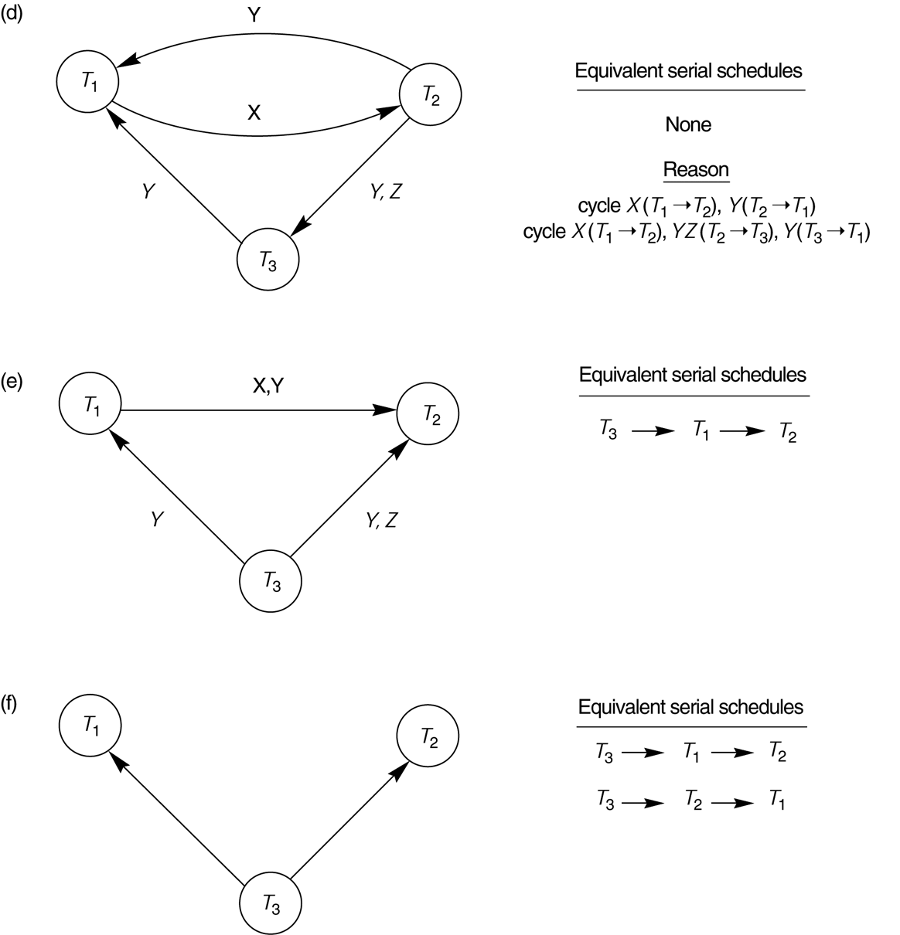
(d) Precedence graph for schedule E.
(e) Precedence graph for schedule F.
(f) Precedence graph with two equivalent serial schedules.

